Slide 1


Entrepreneurship and business modelling
3rd assignment
Value proposition SmartRetail
Adrián Barba Beltrán
Rodrigo Martín Gómez del Moral Herranz
Álvaro Honrubia Genilloud
César Pantoja Rosales
Javier Rodríguez García
Jose Antonio Ruiz Heredia

Slide 2
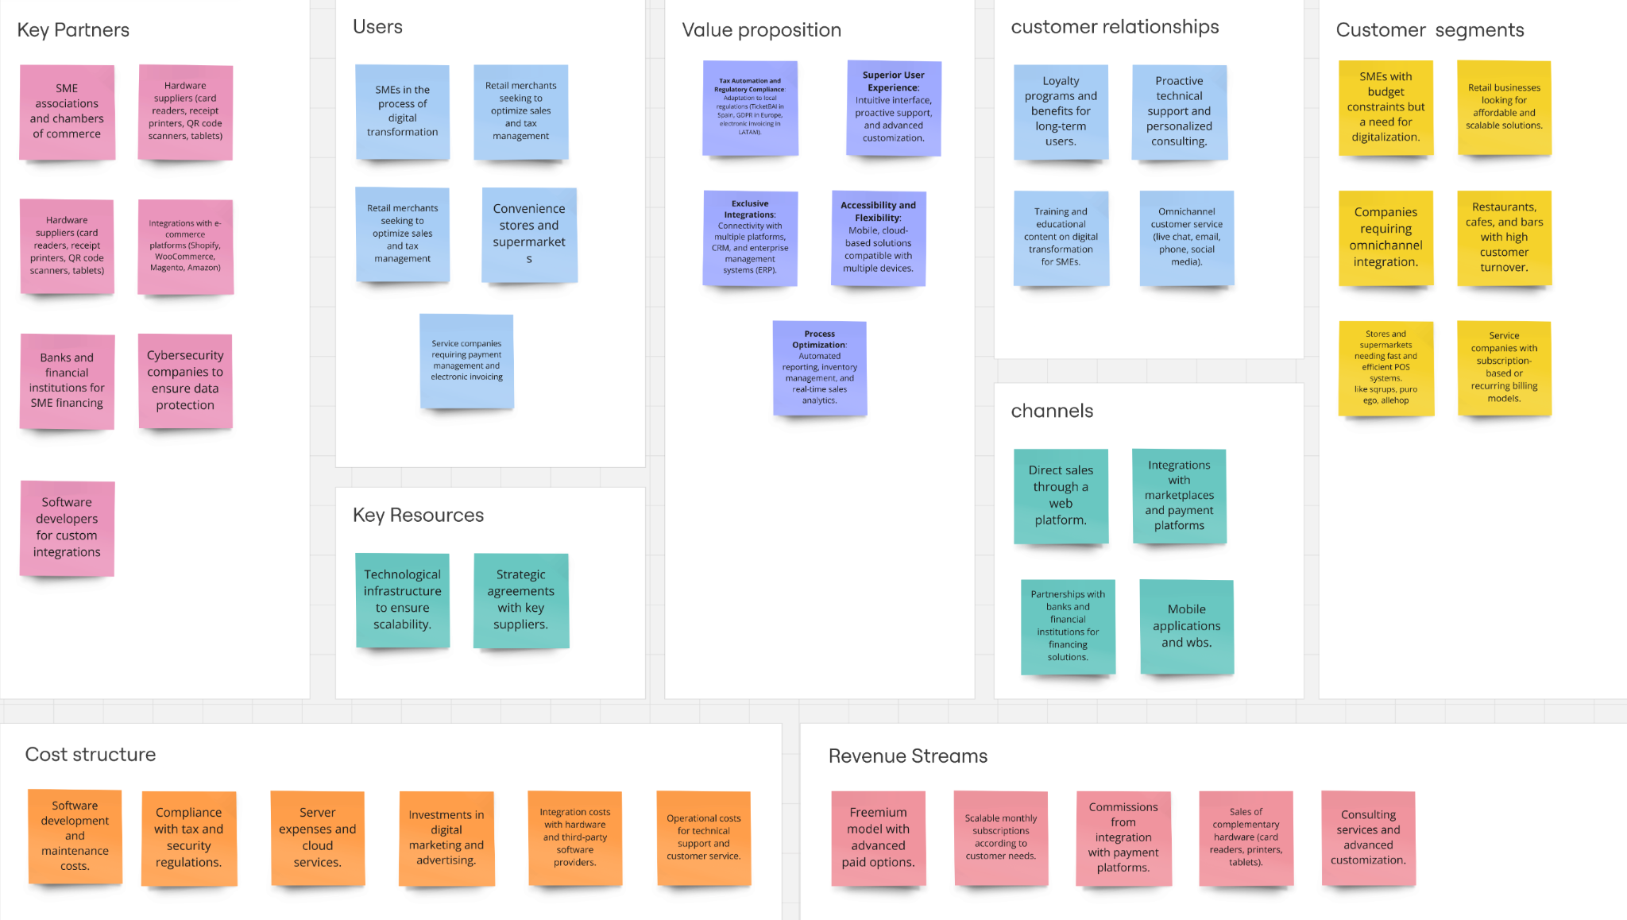

Slide 3
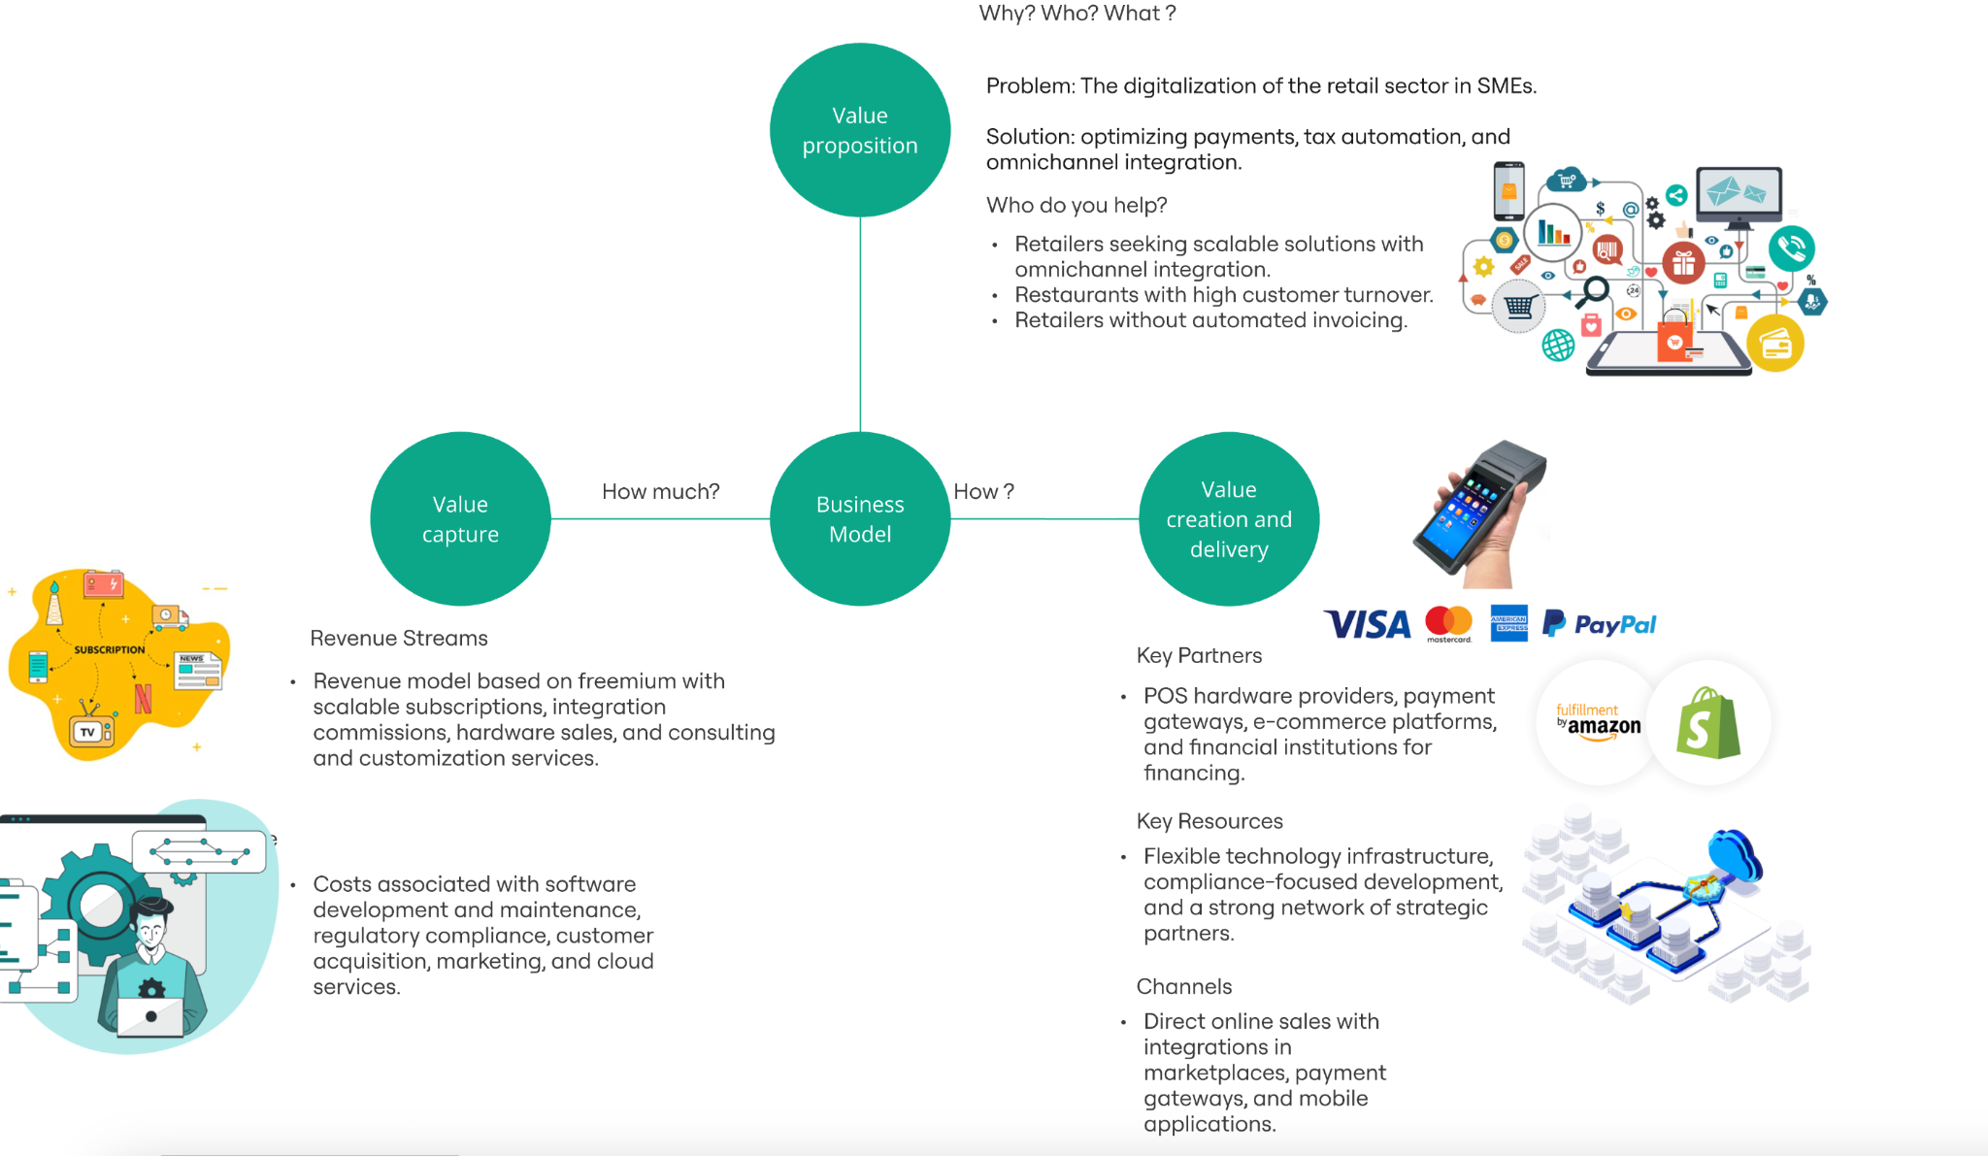

Slide 4



Problem
INTEGRATION & VISIBILITY
SCALABILITY
MAINTENANCE
Disconnected systems for payments, inventory, and customer management
Difficult to track sales, stock, and customer preferences
Software tied to a single device
Cannot access or manage their business remotely
Require dedicated servers, frequent updates, and technical support
Digital transformation is expensive and inaccessible.

Slide 5
Solution
INTEGRATION & VISIBILITY
CLOUD-BASED SCALABILITY
All-in-One platform with all processes in a single system
Real-time insights to improve decision making
Synchronization with E-commerce platforms
Accessible from any device
Multi-store & multi-user allowing multiple locations and accounts
Automatic updates & backup
COST-EFFECTIVE OPERATIONS
NO expensive servers, as it runs on the cloud
Simple & user-friendly interface
Subscription-based model with different plans

Slide 6
Unique offer
What Value Do We Deliver to the Customer ?
Save time by automating manual processes
Increase revenue through data-driven sales and customer retention
Reduce costs by eliminating IT maintenance and expensive hardware
Simplifies management with remote access and real-time insights
Who do we serve ?
Small & Medium Businesses
Basic Affordable Plan
Growth Plan for expanding businesses
Large Retail Chains & Franchises
Enterprise Plan
E-commerce & Hybrid Stores
Unified online + in-store sales management
Why Would Customers Pay for This ?
Manual error and outdated system lead to financial loss
No more wasted hours managing inventory
No more losing customers due to slow or outdated checkout systems
Our Solution helps businesses sell more, operate smarter, and grow faster

Slide 7

Unfair advantage
AI-powered Analytics and Predictive Insights
Optimize inventory
Boost sales
Personalize customer experiences
In-Store, Online and Mobile Sales
Real-time stock & customer tracking across all channels and platforms
Modular and API-Friendly
Integrate new tools without costly migrations or disruptions
Built for Growth, Not Just Transactions
Customer loyalty programs
Automated marketing tools
AI-powered business insights
Simple, Scalable & Affordable for All
Cloud-based model that scales as businesses grow

Slide 8
Customer segments
Traditional & Small-Scale Businesses
Growing & Tech-Integrated Businesses
Businesses with a high volume of transactions
Companies planning to expand to new branches
Clothing, electronics, and cosmetics stores that sell both in physical stores and online
Businesses that operate with E-commerce platforms
Cafés, bars and restaurants with table service and delivery
Restaurants that work with delivery food apps
Small local businesses (bakeries, neighborhood stores, hair salons)
Family-owned businesses with a low technology budget
Businesses that still use manual cash registers or Excel for record-keeping
Supermarkets, minimarkets, and convenience stores

